Slide 1
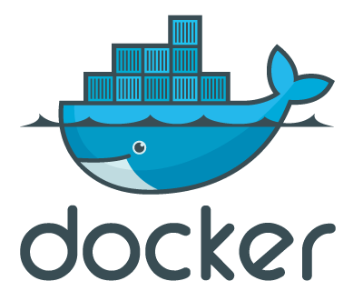
Docker Hack Night
Clustering

Slide 2
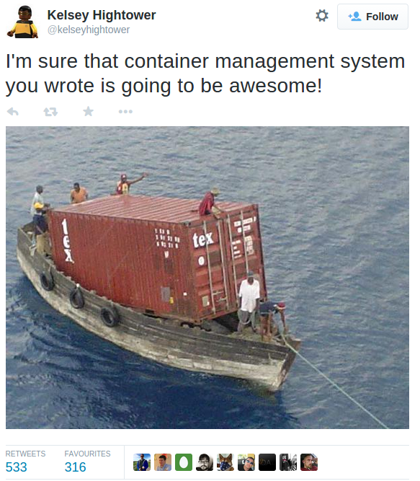

Slide 3
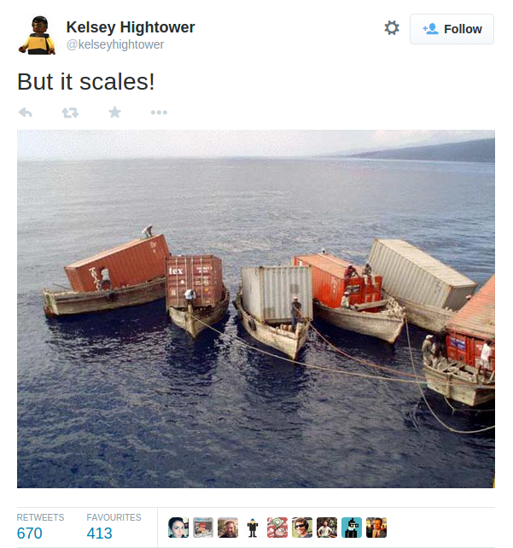

Slide 4
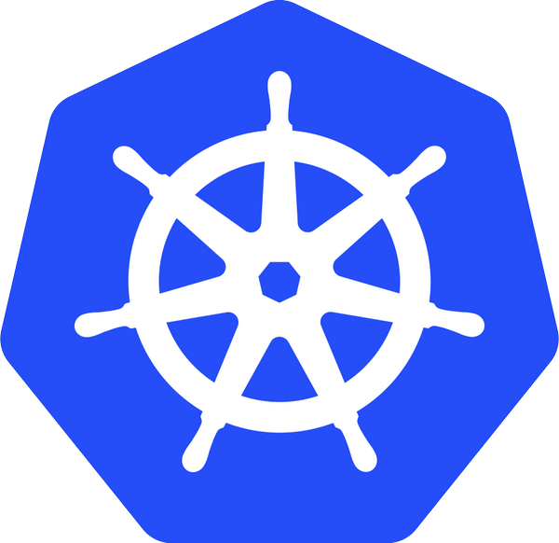

KUBERNETES
Greek for “pilot” or “helmsman of the sheep”
Open Source container management from Google
OPENSHIFT
Cloud Application Platform from RedHat

Slide 5
Pods: Co-located, ephemeral groups of containers. Public IP address. Arbitrary labels
Replication Controller: Manages lifecycle of a selection of Pods
Services: Provides stable entry to selection of ephemeral Pods.

Slide 6
Replication Controller
Template: container=web replicas: 3 selector: name=web
env=prd
Service
select: name=web
env=prd
Pod
Name: web
container:web
label: env=prd
Replication Controller
Template: container=db replicas: 1 selector: name=db
env=prd
Service
select: name=db
env=prd
Pod
Name: db
container:db
label: env=prd

Slide 7
OK, so let’s go!

